Slide 1

Adidas US Sales Dashboard Overview
Interactive Dashboard & Key Insights Summary

Slide 2
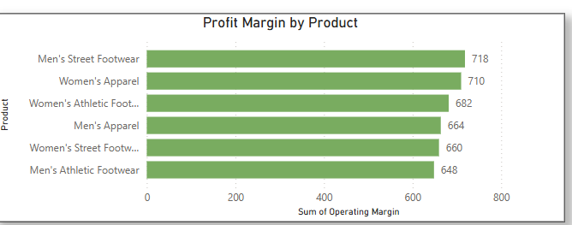
Key Insights Slide
Sales increased significantly in Q4 2024.
Northeast region outperformed others by 15%.
Men's Athletic Footwear had the highest profit margin.
Promotional campaigns boosted urban sales by 20%.

